Slide 1
Introduction to plotting in R

Slide 2
Get data
Download package with our data in
devtools::install_github("n8thangreen/dataPakistan")
Load the package with the data in
library(dataPakistan)
Take a look at what data is available
system.file("extdata", package = "dataPakistan")

Slide 3
Should look like this:
[1] "Admin-datasheet-year2018.xlsx" "ICM-datasheet-year2018.xlsx" "List of AFP Cases 2015-2019.xlsx"
[4] "List of Env Samples 2015-2019.xlsx" "List of NON POLIO AFP Cases 2015-2019.xlsx" "LQAS %Pass _ District level_ Sep18-Mar19.xlsx"
[7] "LQAS UC level_ Sep18-Mar19.xlsx" "MPQA _March SNID.xlsx" "Population under 15-estimates 2018-19 as 190510.xlsx"

Slide 4
Where we will get to…

Slide 5
Graph 1:Distribution of AFP Cases by Month, Pakistan 2015-2019*
Cases (n)
2015
2016
2017
2018
2019
* Afp.rec Data as of 15-07-2019
Notes:
5

Slide 6
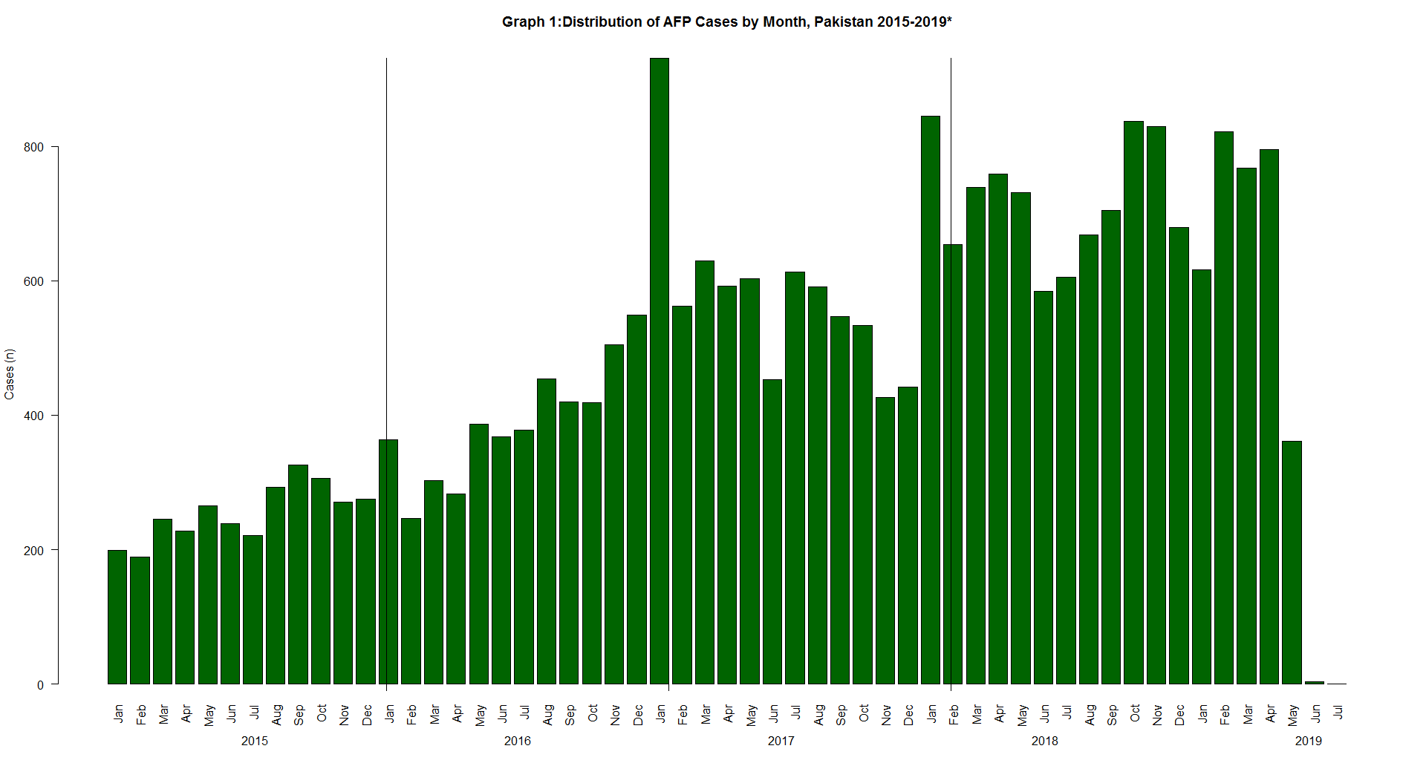

Slide 7
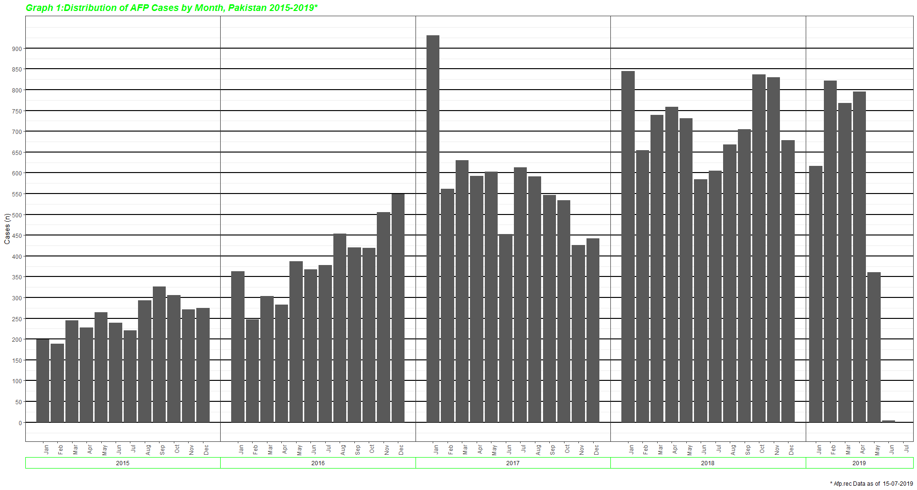

Slide 8
Environmental Sampling Results 2015-19* pakistan

Slide 9
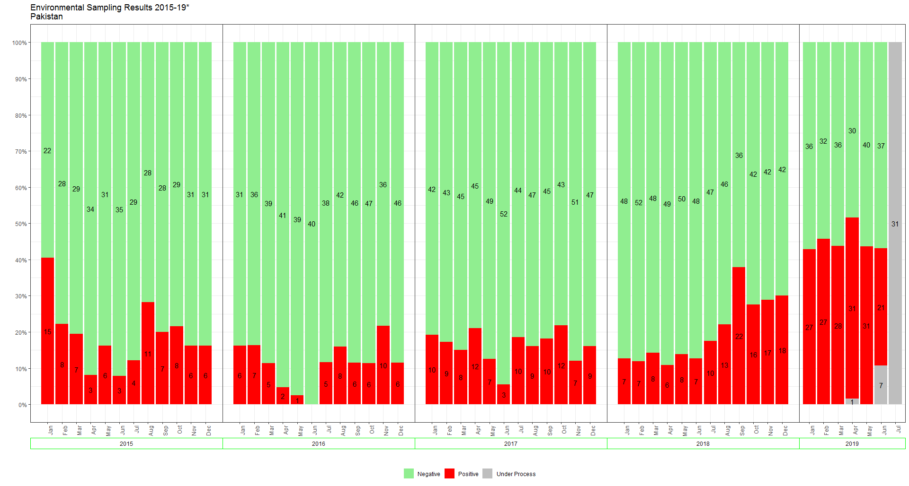

Slide 10
Summary of MPQA results
SUMMARY OF MPQA RESULTS
Micro Plans of Tier-1 Districts from Karachi town, Quetta Block and Peshawar/Khyber are passed
Substantial gaps identified primarily in Balochistan and pockets of KP and Sindh

Slide 11
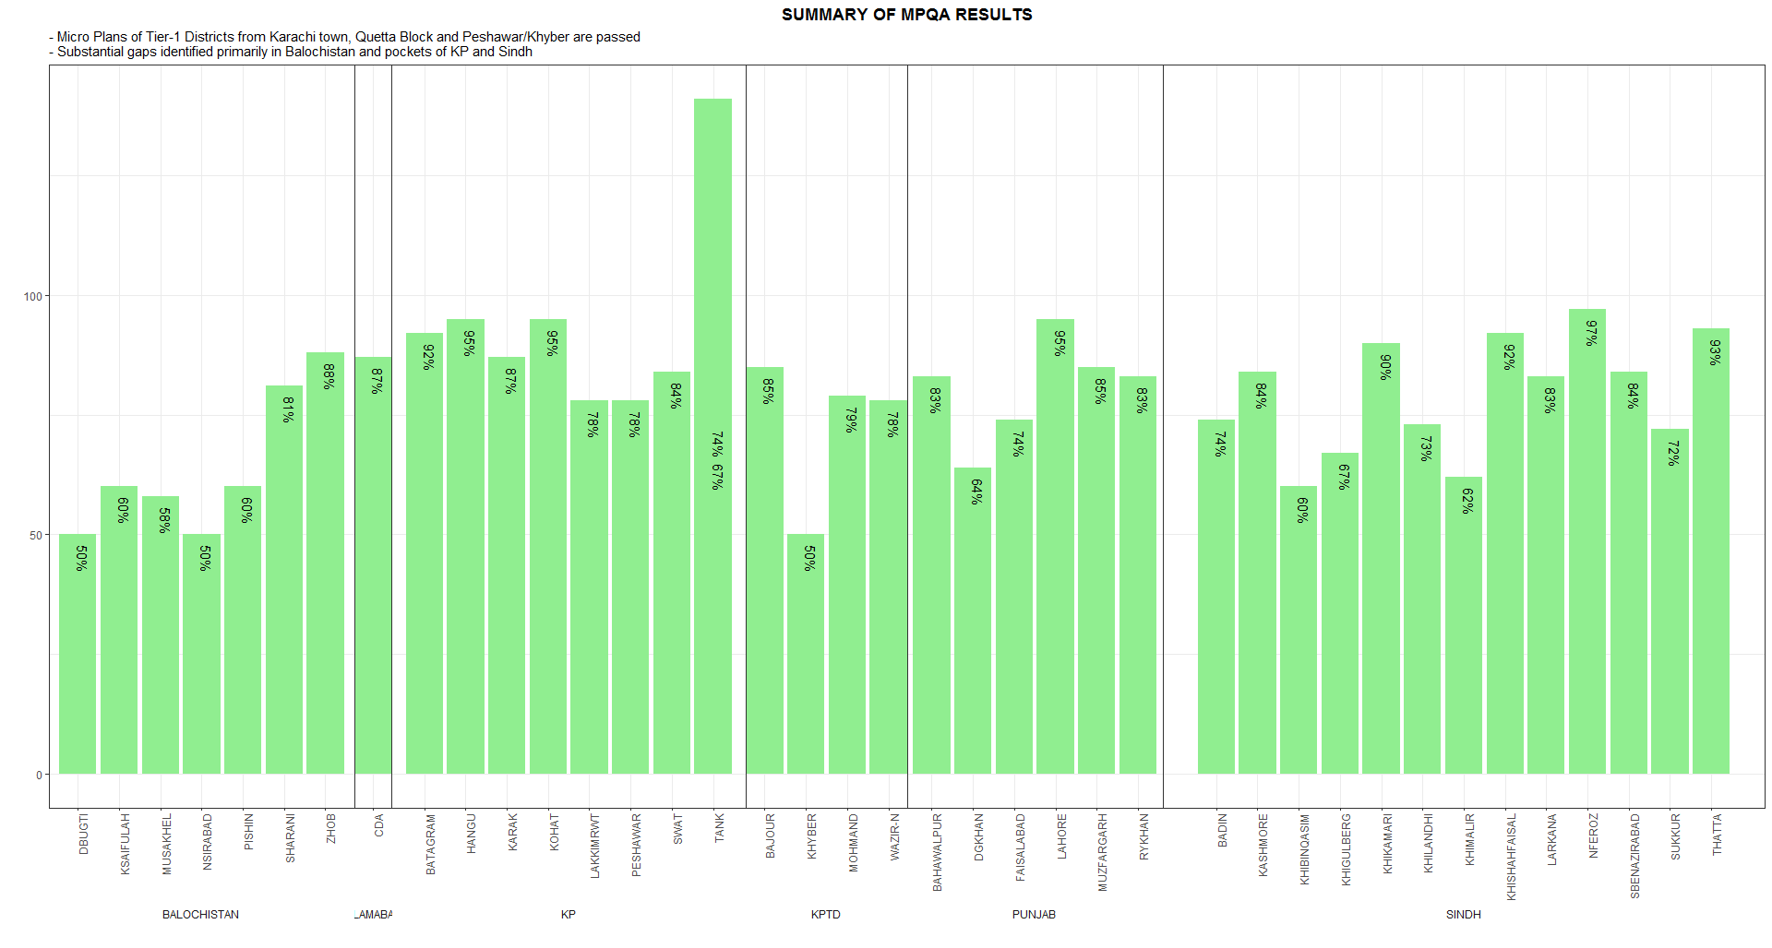

Slide 12
What plot?
 | January | February
North | 1 | 2
South | 2 | 2
East | 3 | 3
West | 4 | 3

Slide 26
Exporting (saving) figures in file
There are two ways in which figures and plots can be output to a file (rather than simply displaying on screen).
1. (easiest) is to export directly from the RStudio ‘Plots’ panel, by clicking on Export when the image is plotted. This will give you the option of png or pdf and selecting the directory to which you wish to save it to. It will also give you options to dictate the size and resolution of the output image.

Slide 27
2. Use R functions and have the write to file hard-coded in to your script.
This would allow you to run the script from start to finish and automate the process (not requiring human point-and-click actions to save). In R’s terminology, output is directed to a particular output device and that dictates the output format that will be produced. A device must be created or “opened” in order to receive graphical output and, for devices that create a file on disk, the device must also be closed in order to complete the output.

Slide 28

1. initialize a plot using a function which specifies the graphical format you intend on creating i.e.pdf(), png(), tiff() etc. Within the function you will need to specify a name for your image, and the with and height (optional). This will open up the device that you wish to write to:

Slide 29
If you wish to modify the size and resolution of the image you will need to add in the appropriate parameters as arguments to the function when you initialize. Then we plot the image to the device, using the ggplot scatterplot that we just created.
Eg plot(x,y)

Slide 30

Finally, close the “device”, or file, using the dev.off() function. There are also bmp, tiff, and jpeg functions, though the jpeg function has proven less stable than the others.

